Slide 1

Data Excel File Docs File
Vishnu Deshpande

Slide 2
ANALYSIS – OPENING NEW RESTAURANT
Analyzing Countries with less competition.
States and Cities for opening new restaurant.
Rating – in the suggested country.
Total expenditure on food – in the suggested country.
Competitors.
Cuisines.
Online delivery / table booking.
Restaurants in different price range.
Dashboard.

Slide 3




COUNTRY
The selection of countries has been done on the basis of two factor:
Less Competition
The ratings are average in the countries – the rating has been taken into consideration as this indicates the people are not satisfied with the type of restaurant that are there.

Slide 4
Country – SELECTED CITIES
CANADA
YORKTON
PHILIPPINES
SINGPORE
SRI LANKA
SANTA ROSE
SINGAPORE
COLOMBO

Slide 5
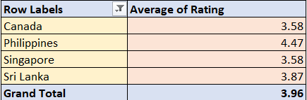
AVERAGE RATING OF RESTAURANTS IN SELECTED COUNTRIES
The ratings in the selected countries are in the range 3.58 to 4.47. The average of ratings are giving insights that people are not fully satisfied with some restaurants.
And hence its an opportunity for us to attract the people by providing the best of food and services.

Slide 6
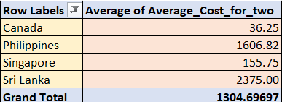
Expenditure on Food

Slide 7
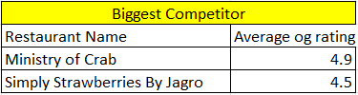

FEW RESTAURANT NAMES - BIGGEST COMPETITORS
RESTAURANTS WITH LOW RATING

Slide 8
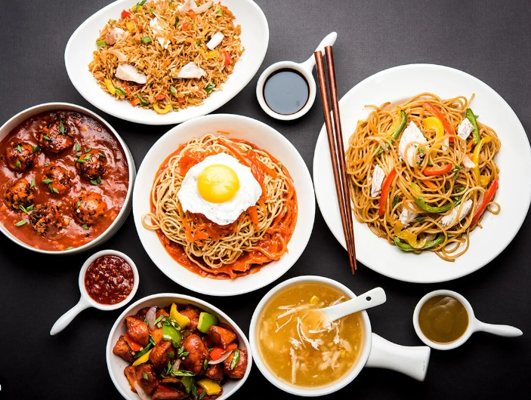
CUISINES with TOP RATINGS
These are the cuisines in the suggested four countries with high number of ratings.
These are some cuisines in all the four countries. It includes local food of that country and some other cuisines.
Top preference cuisines are seafood and Italian.
CUISINES:-
American, Asian, Seafood, Italian, Filipino, Japanese, Korean, Sushi, Steak, European, café, Pizza, Indian, Mediterranean.

Slide 9
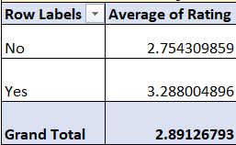
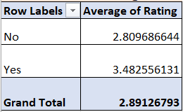
DELIVERY- ANALYSIS
ONLINE-DELIVERY
TABLE - BOOKING

Slide 10
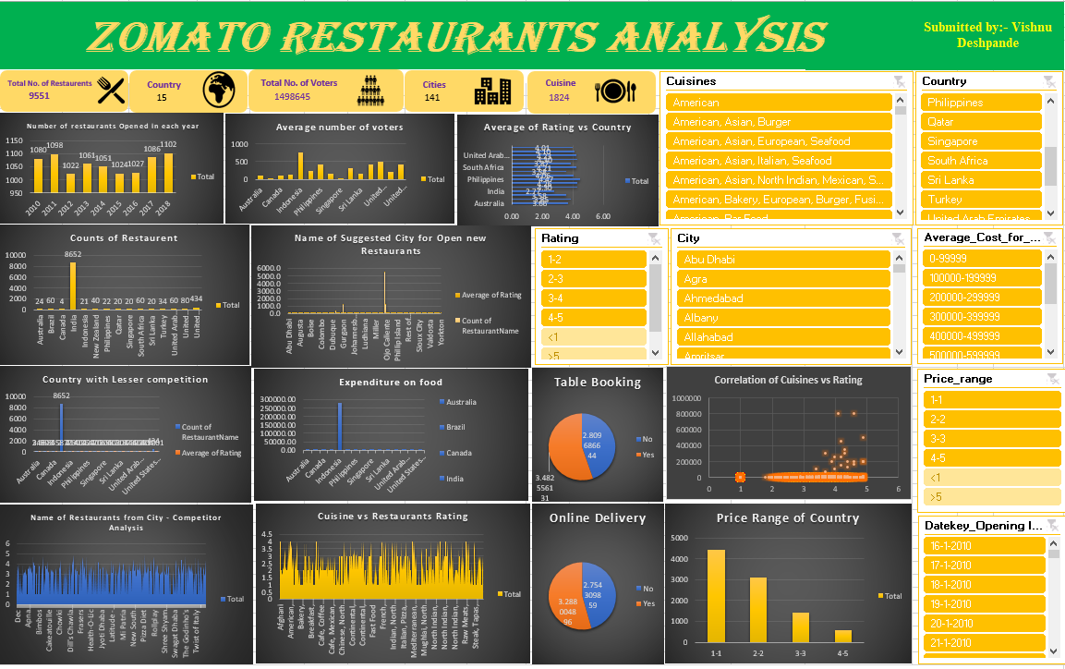
DASHBOARD

Slide 11

THANK YOU

